Slide 1
The Expansion of the Christian Movement
Acts 28 – AD 1900
Notes:
Good evening!

Slide 2
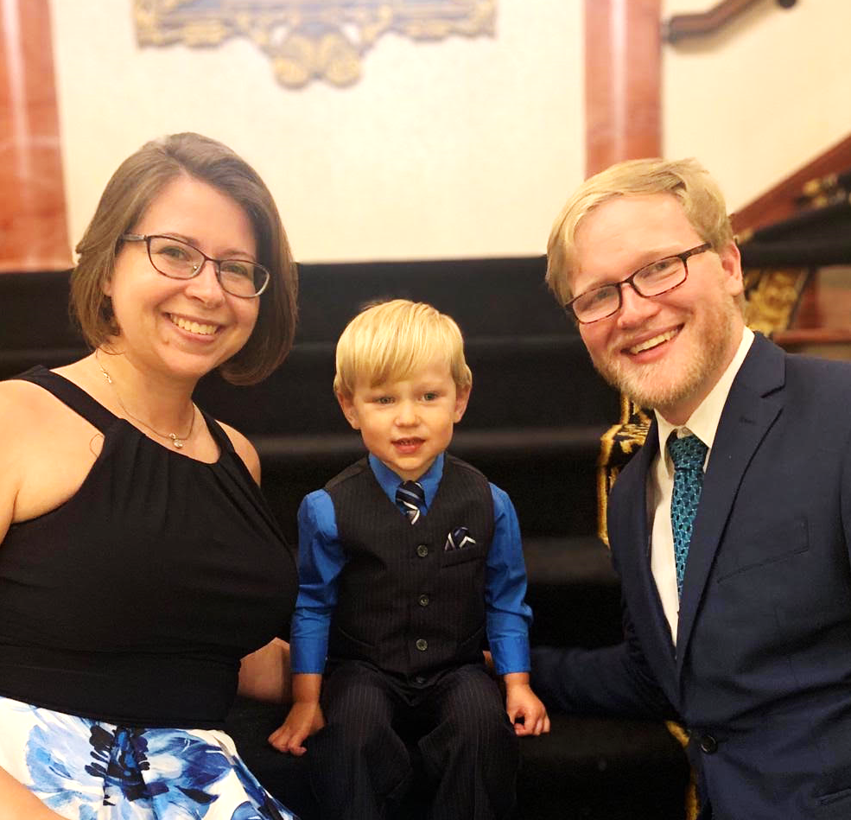
The Sorges
Notes:
(Introduce self)
David Sorge and Family

Slide 3
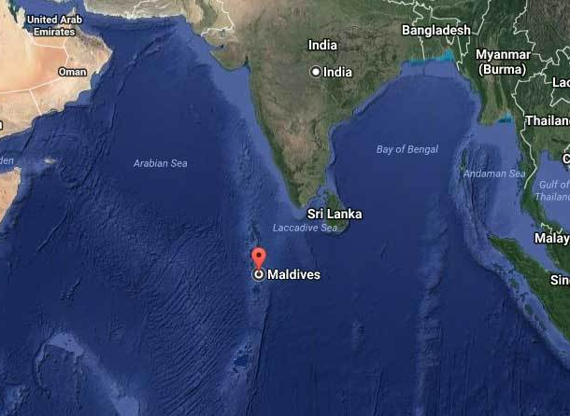

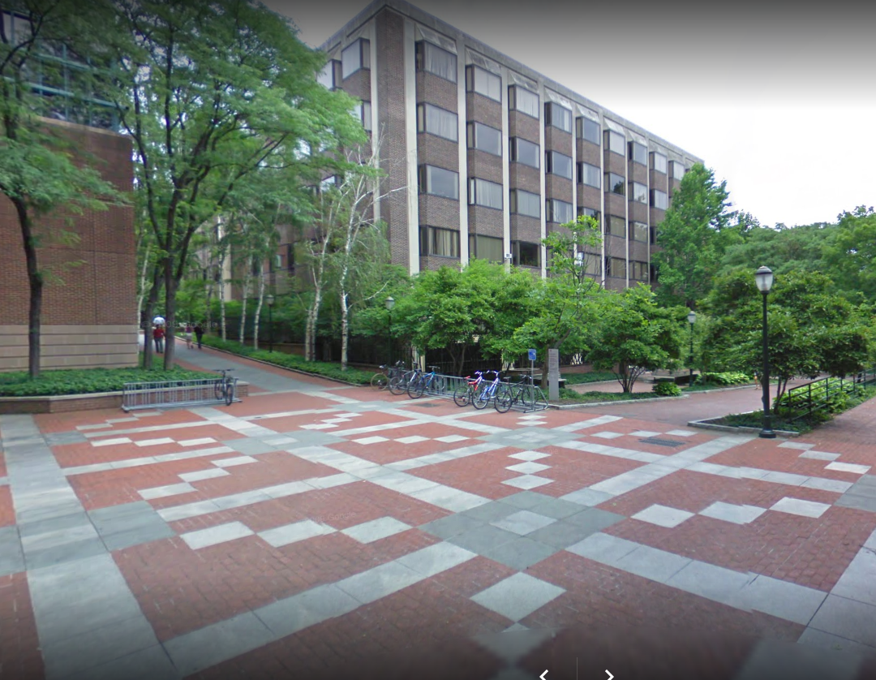
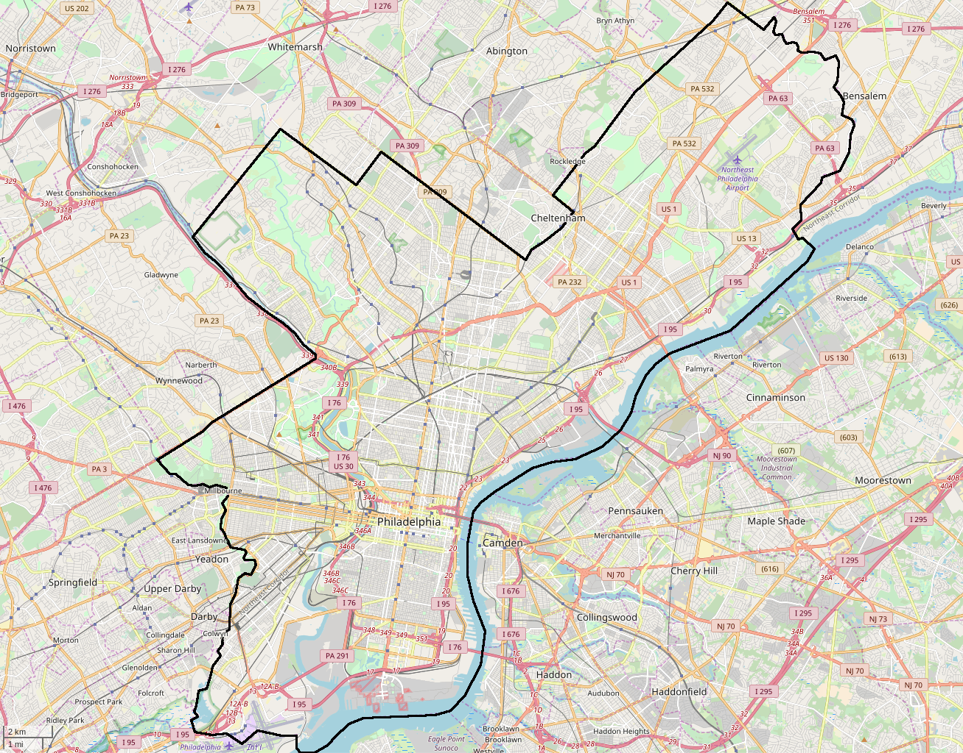
From a set of Islands barely on the map . . .
. . . to a city we both know well.
Notes:
Graduate student and occasionally an instructor at the Univ. of Pennsylania
Working on Sociology with a particular eye for seeing how politics and religion have shaped history here and around the world.

Slide 4
An Impossible A Difficult Task
2000 years
5 continents
2 hours
We need a viewpoint, and a framework.
Notes:
A difficult task, for all of us:
Nearly 2000 years, 5 continents, in 2 hours.
(I still haven’t managed to get through all 2000 years in one go yet—I usually end up having to drop the last 400 years. Blame the people who put the syllabus together.)
History is a difficult thing: little bits of information from people who thought and lived very differently from the way we do.
The realities of history are always interpreted through someone’s lens, so the same event often has multiple interpretations
So we need a framework and a viewpoint.

Slide 5
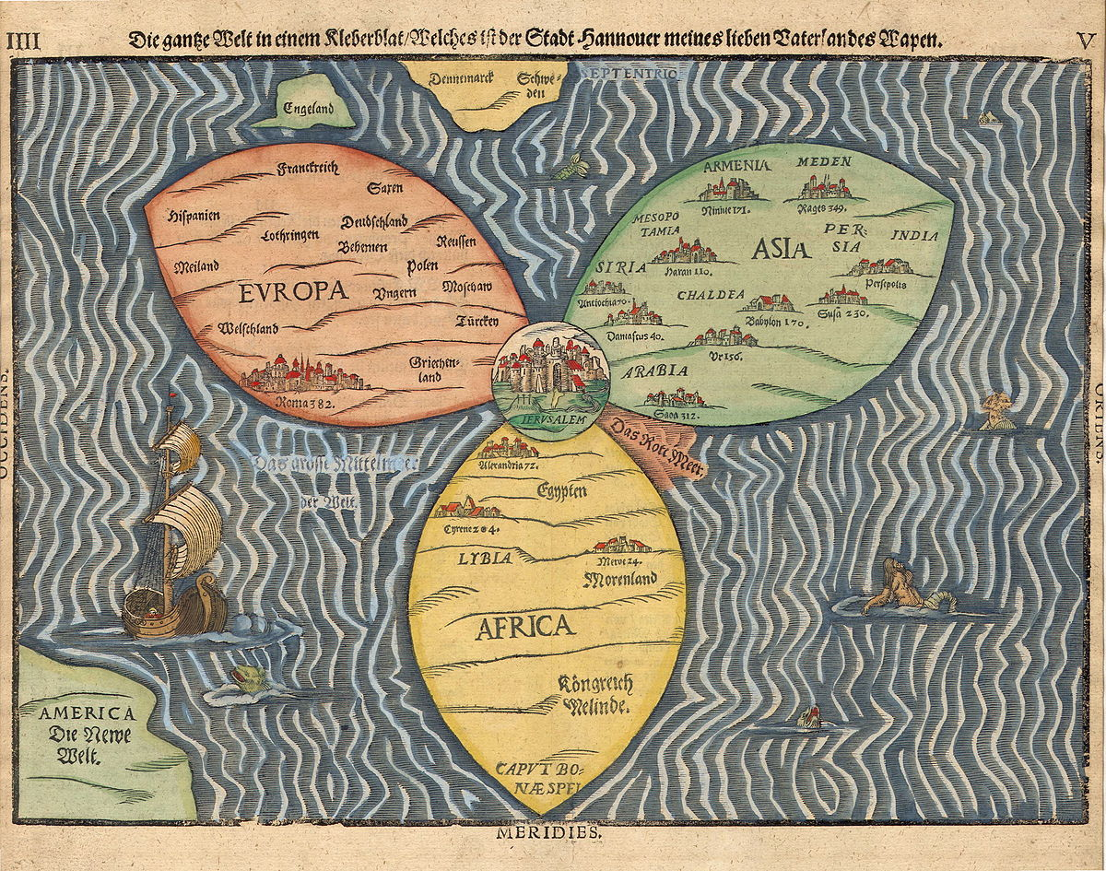
Carving up Space: Heinrich Bünting’s “Clover-leaf” map, 1581
Notes:
Space: Clover leaf map, based on even older maps that thought of the world as having 3 continents, a way of seeing the world that goes back (at least to 636).
(Yes, they had known the earth was round for several centuries)
They were intended as a simplified projection of one hemisphere of a globe. There were significant arguments about whether the other side was entirely water, or whether there existed other land masses—antipodes--on the assumption that God wouldn’t create an asymmetric world. Most everyone agreed that the antipodes couldn’t be populated, as that would render Jesus’ command to his disciples to “make disciples of all nations” impossible, since the antipodes were agreed to be unreachable.

Slide 6
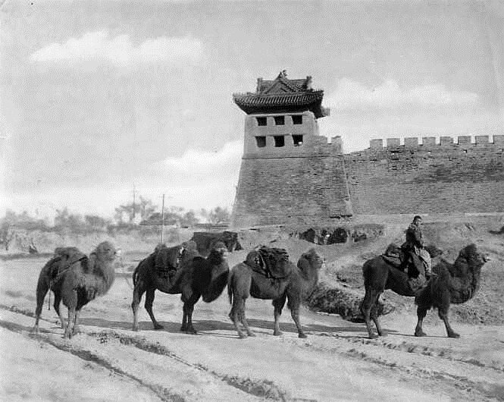
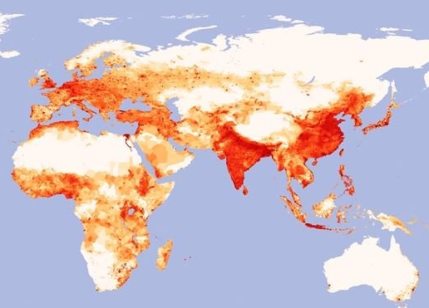
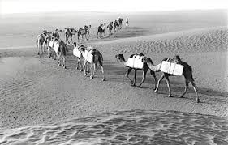
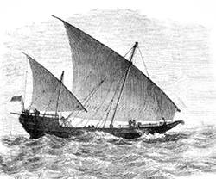
In a way that might not be crazy...
Cold Desert
Bactrian Camel
Hot Desert
Modern-Day Population Density Map of the “Old World”
Wet Desert
Arabian Camel
Sea Camel
Notes:
Of course, all of these are

Slide 7
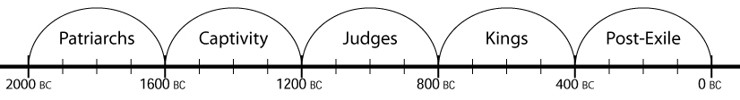
Carving up Time: Before Christ
Notes:
Time: Winter’s framework of 400 year “epochs”

Slide 8
Viewpoint:
Through the eyes of contemporary missions history and missiology
Through the eyes of people the people who lived through the moments of history we discuss
Through the eyes of people who had to make difficult choices about how the gospel should go forward.
Notes:
Through contemporary missiology and missions history
(Rooted in the European tradition of history-writing, but newly realizing how much of the story the Eurocentric, male-centered history has been missing.)
Attempting to see history through the eyes of people who lived there.
It takes an act of imagination and empathy to try to understand another’s view of the world.
Imaginative engagement: Fictional letters from historical figures write to ask for advice. I ask your groups to help them think through their decisions.
Whose stories?
People who had unique insights into key moments of the spread of the good news of Jesus to the nations – missionaries, queens, explorers and nuns

Slide 9
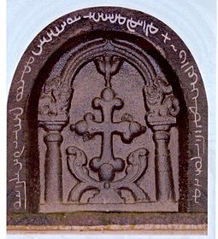
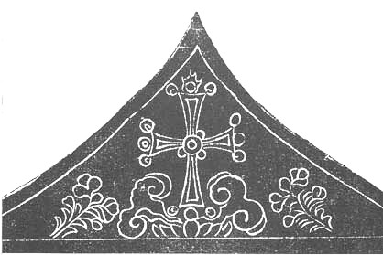

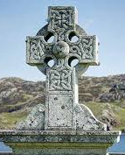
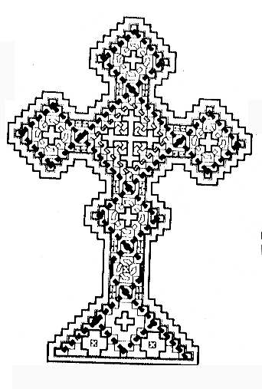
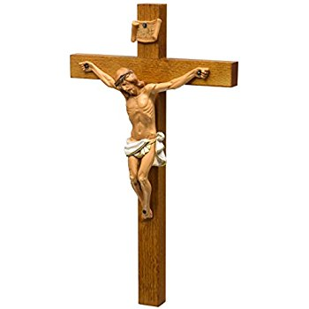
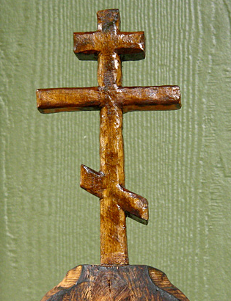
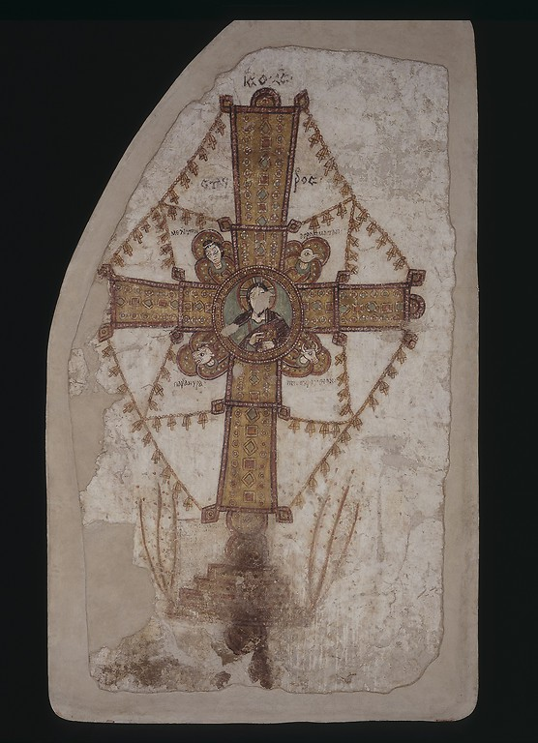
So don’t let anyone boast about mere human beings. For everything belongs to you, whether it’s Paul or Apollos or Cephas, whether it’s the world or life or death, whether it’s the present or the future – everything belongs to you! And you belong to the Messiah; and the Messiah belongs to God.
(1 Cor 3:21-23)
Notes:
There’s one more conviction that shapes this viewpoint—something I grew up with in a team of Lutherans, Baptists, Prebyterians, Non-denominationals. Off the front lines, those distinctions can come to mean quite a lot, but for us, as we worked to proclaim Christ and him crucified, we routinely forgot that we were from such different theological backgrounds because what bound us together—Jesus—was so much more important.
Paul seems to have had the same sort of thing in mind when he wrote in 1 Corinthians 3:
³ You’re still determined to live in the old way! Yes, wherever there is jealousy and quarrelling, doesn’t that mean you’re living in the old way, behaving as any merely human being might do? ⁴ When someone says ‘I’m with Paul!’, and someone else says ‘I’m with Apollos!’, are you not mere humans?
⁵ So what d’you suppose Apollos actually is? What d’you think Paul is? I’ll tell you: servants, through whom you came to faith, each one as the Lord gave. ⁶ I planted and Apollos watered, but it was God who gave the growth. ⁷ It follows that the person who plants isn’t anything special, and the person who waters isn’t anything special; what matters is God who gives the growth.
²¹ So don’t let anyone boast about mere human beings. For everything belongs to you, ²² whether it’s Paul or Apollos or Cephas, whether it’s the world or life or death, whether it’s the present or the future – everything belongs to you! ²³ And you belong to the Messiah; and the Messiah belongs to God.
In the same way, I’d encourage you, for the time being, to set aside the differences in theology, for the moment, between Protestant, Catholic, Orthodox, Nestorian, Monophysite. To the degree that we are proclaiming Christ as Lord, we are all working together.

Slide 10
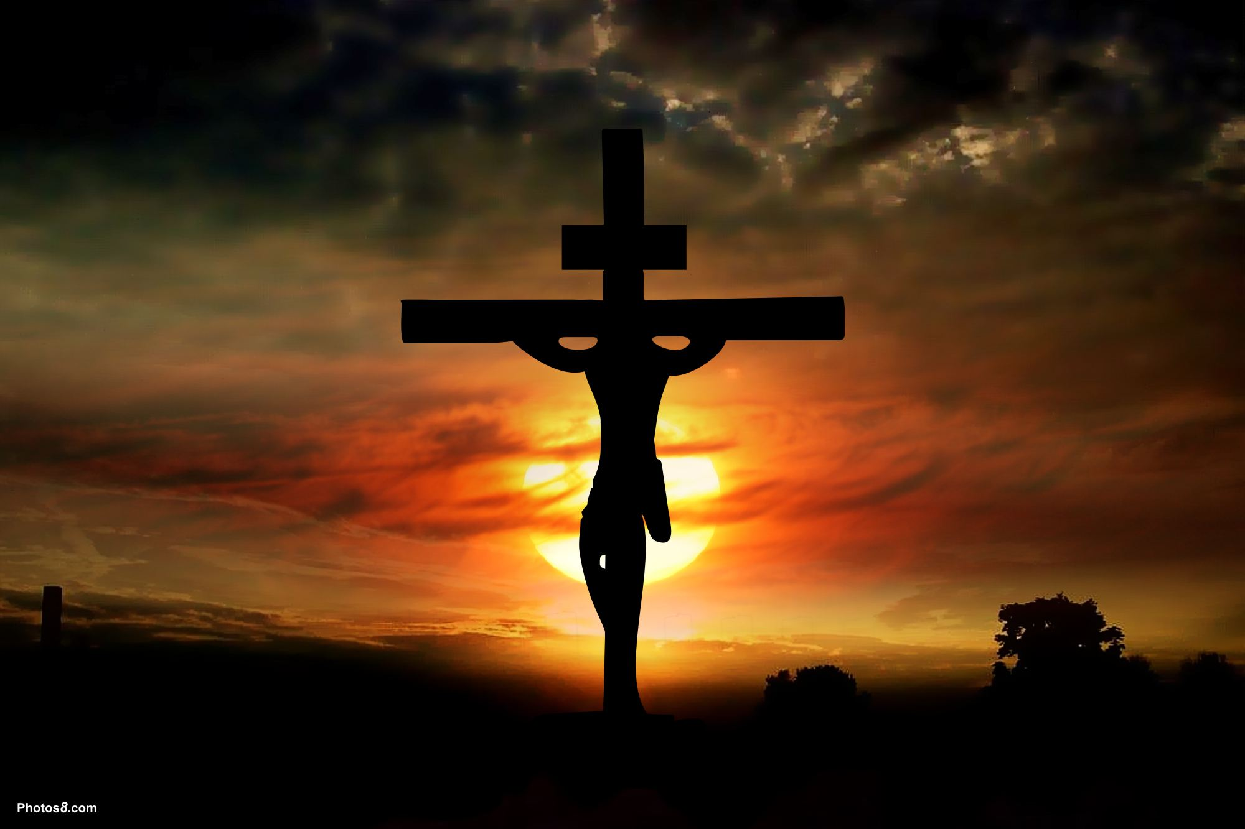
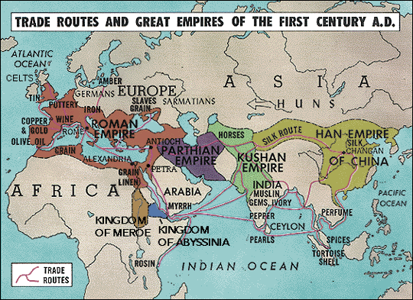
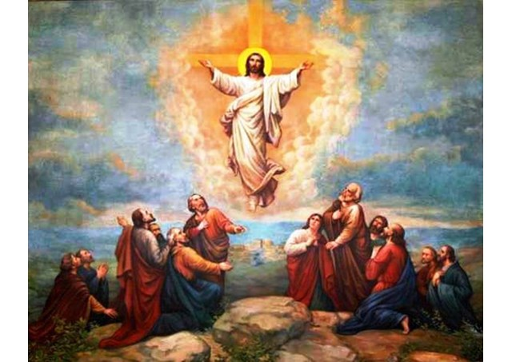
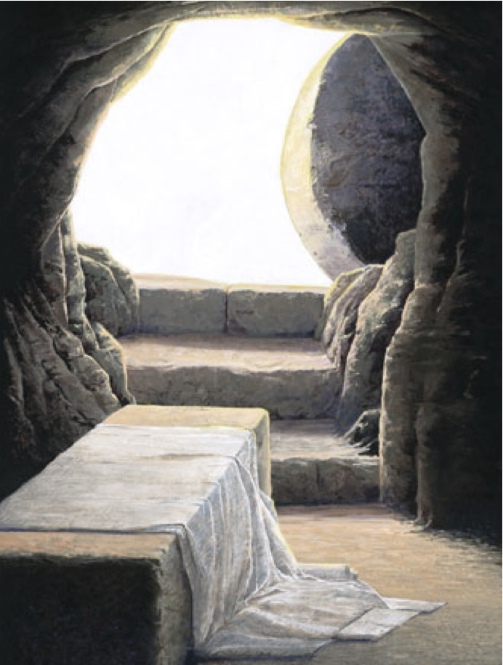
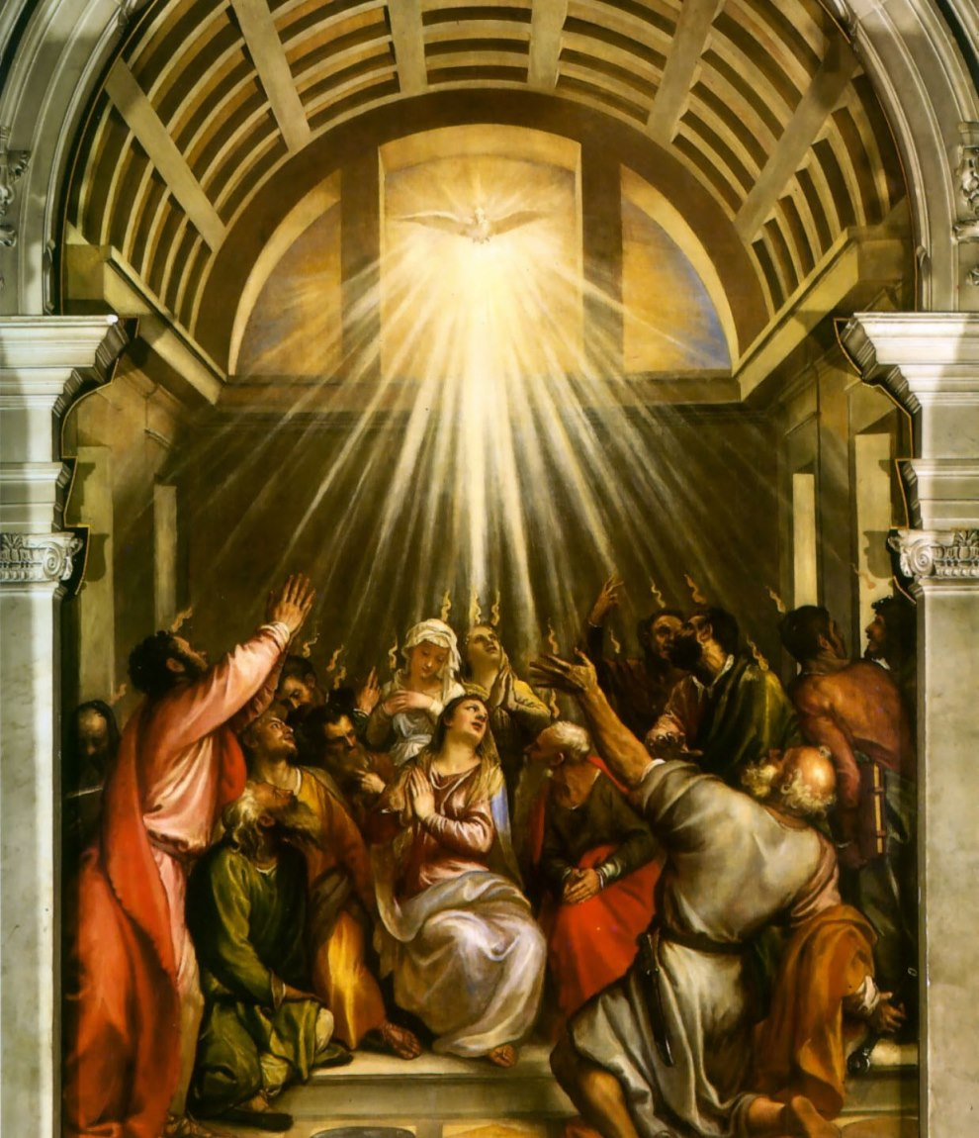
Round 1: The world of the Apostles
Notes:
Introduction: The world of the Apostles
The word gospel means “Good News.” And like any other news, it is about events that happened in a place, at a time, with a particular meaning for the world.
In this case, the events happened in a moment in history when large empires covered much of Europe and Asia, and trade routes were easily accessible by land and sea. The Roman roads, the silk road, the sea routes to Asia, and the route down the Nile to Africa were all roads that the gospel began to take. As the churches in these places began to grow, though, they started to run into some tricky dilemmas.

Slide 11
Round One
You’ll find a letter (labelled 33-400) on your table.
Take 7 minutes to read the letter and talk about what advice you would give.
Then, briefly share your dilemma and your approach to it with the class at large.

Slide 12
Africa, AD 200
The good news has reached Egypt and Libya!
Society is split between upper-class Greek- and Latin-speaking colonists, and lower-class locals who speak Coptic, Punic, and Berber.
Brilliant theology being written in Greek and Latin
But locals are more interested in strict local versions of Christianity
Ascetics and hermits going out into the desert to battle demons
A group that says communion doesn’t “work” if you don’t get it from the right person
These groups also support translation into local languages
Should we focus on integrating the locals into colonists’ churches?
Or support the local groups by translating the scriptures?
Notes:
The Gospel got there, tradition says through John Mark
It encountered a society split between the upper-class Greek and Latin speaking colonists and the lower-class locals who spoke Coptic, Punic, and Berber.
What was your answer?

Slide 13
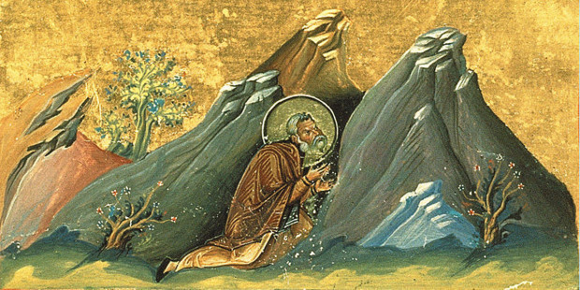
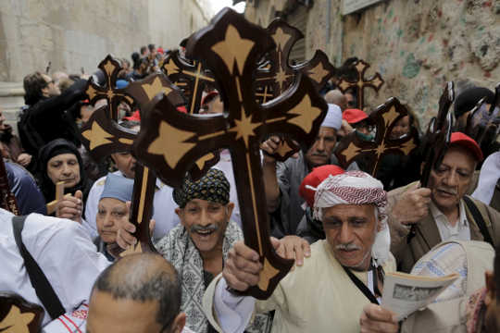
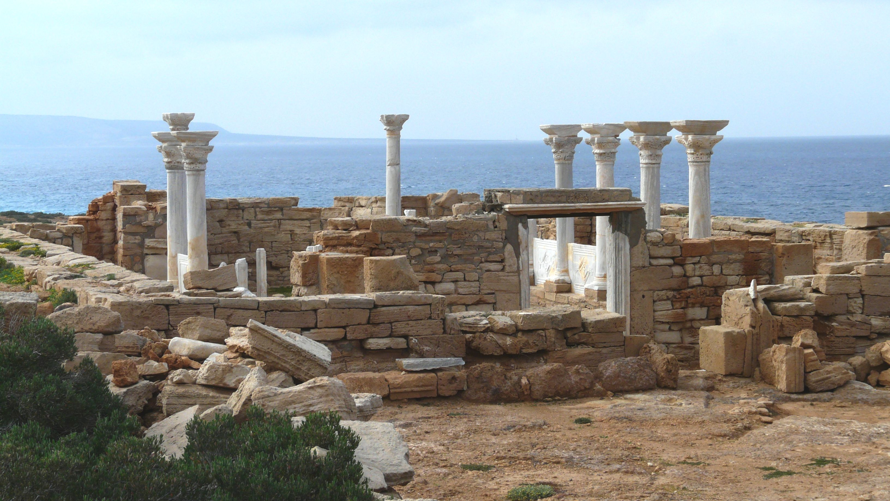
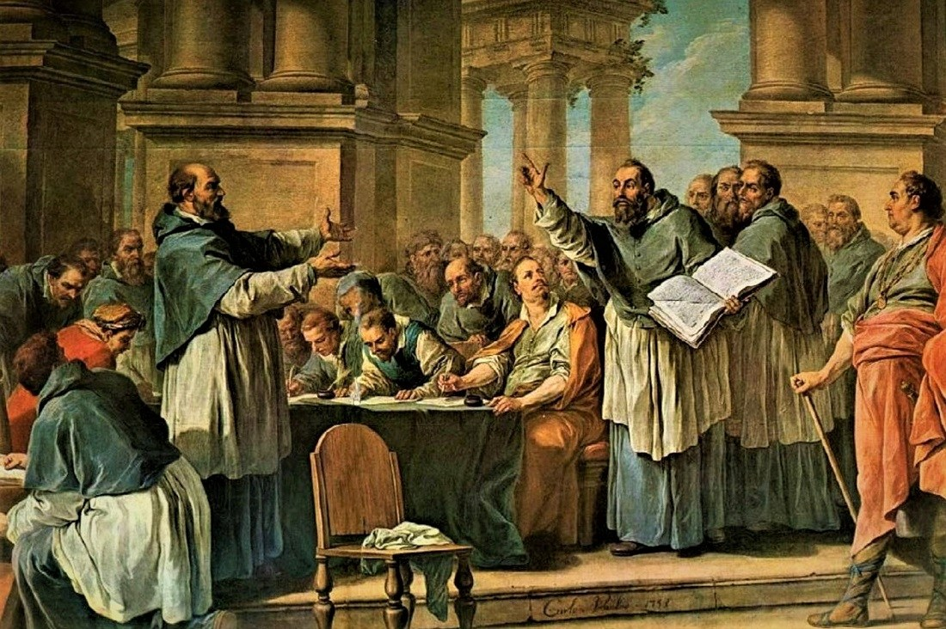
Africa, AD 33 – AD 400
Egypt
Translated Bible into Coptic, while scholars also wrote in Greek Early ascetics started the tradition of Christian monasticism. When Romans and Copts quarreled, the church split into Roman and Coptic branches Coptic Christians are a robust minority in Egypt to this day
Libya
Translated Bible to Latin, but not Berber or Punic Strict Donatists were violently suppressed Roman colonists became Christian, but locals had no scriptures and few teachers In the 600s, Arabs conquered North Africa. Roman colonists left, and most locals became Muslims
Notes:
Here’s what happened:
In Egypt, church leaders embraced the odd ascetics, translated the scriptures into Coptic, and allowed the church to indigenize. It is still with us today.
In Libya, church leaders violently suppressed the indigenous Donatist movement, and never translated the Bible in to Punic or Berber. As a result, the lower class people’s theology tended to follow whoever was in power: Christian under Rome, Arian under the Goths, Muslim under the Arabs. Only in later years did the Copts begin to gain a foothold, and only since the 1930s have there been attempts to translate the Bible into Berber.

Slide 14
Rome, AD 312
The gospel has spread through the Roman Empire
Christians are persecuted by the government, but admired by neighbors
One of the generals fighting to be emperor says he saw a vision, telling him to use the sign of the cross to defeat his enemies.
Some think it is a political move to get the support of Christians
Having a general conquer in the name of Christ could end our persecutions
But what if enemies of Rome and enemies of God get confused with each other?
Should we accept the general’s claim to be a Christian?
Or should we denounce him for using Christ to advance his agenda?
Notes:
The gospel had already gotten quite a strong foothold in the Roman empire, especially in the cities, but the persecution was an ever present source of fear and sadness for the Christians.
What was your answer?

Slide 15
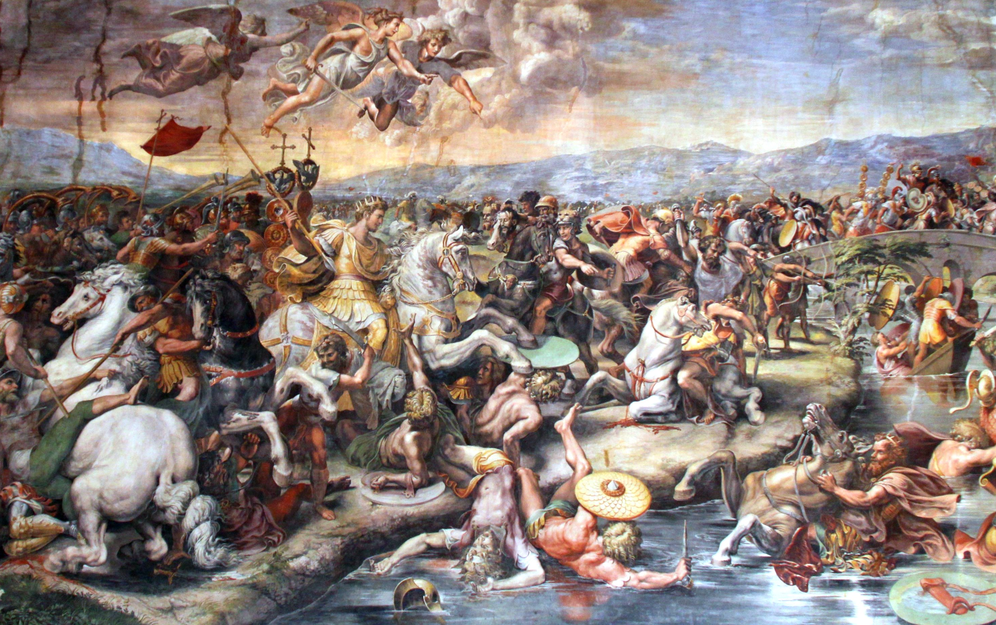
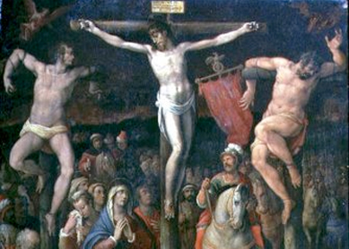
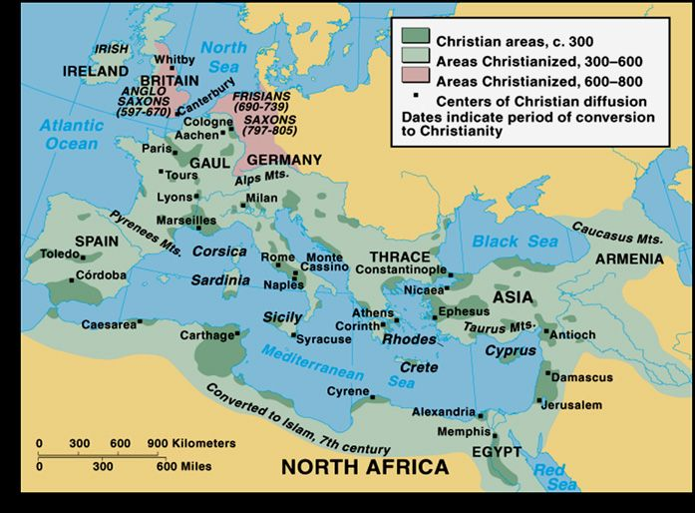
Europe, AD 33 – AD 400
Throughout the empire, persecution ended, Christian communities grew, flourished, and spread from city to city via the Roman roads, and from city to countryside!
Notes:
Here’s what happened:
If you know your history, you know that the general in question, Constantine, did become a Christian, and the church generally embraced his conversion. This led to some great things—the end of persecution and a political safe haven for Christianity.
But it also came at a price. It changed people’s ideas of what Christianity meant, from a movement following a Messiah killed by the empire, willing to die themselves rather than give him up, to a movement allied with the empire—an empire just as bloody, but now killing in the name of the Cross.

Slide 16
Europe, AD 33 – AD 400
325: Arian Christians went North to the Barbarians
Theological disputes
+
Imperial power
431: Nestorian Christians
went to Persia to join the Church of the East
Violent Persecution
451: Coptic Christians separate in protest and head South
Notes:
There was another consequence to this as well. When disagreements got heated, church leaders realized they could use the tools of the empire for their own purposes. So from persecuted, they became persecutors, and in the process drove away many of those who followed Jesus, but had a different understanding of Theology.
First to go were the followers of Arius, who emphasized the hierarchy between the Father and the Son. They went North to the Goths and Vandals.
Next to go were the Nestorians, who emphasized the separateness of Jesus’ divine and human natures. They found refuge in the Church of the East, and since that time Western Christians have tended to call the whole Church of the East Nestorian.
Then went the Coptic Christians, who emphasized the unity of Jesus’ divine and human natures—just the opposite of the Nestorians. In protest against political strongarming at some of the church councils, they decided to cut ties with the imperial church and focus on Egypt and Africa to the South.

Slide 17
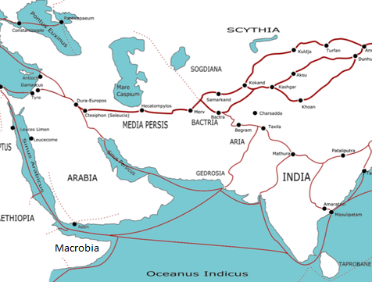
Asia, AD 340
The good news has already reached Persia and South India!
Constantine accidentally set off a violent persecution.
“I ask you to protect [the Christians].” – Constantine
“[Bishop Simon] wants to arouse his disciples and his people to rebel against my Empire!” – Shapur II
Afterwards, the church needed leaders.
Should we bring the hermits who survived down from the mountains to serve as pastors?
Should we keep a strong monastic tradition to survive future persecutions?
Notes:
In Asia, the good news followed the trade routes, but the Church of the East had to become independent quite early because the war zone between Rome and Persia lay between them and the Church of the West.
In Persia, many received the gospel, and it was allowed to grow and prosper until about the reign of Constantine. Constantine’s conversion, and an ill-advised letter to the Persian Shah led to persecution so severe that some estimate that more Christians were killed in those 40 years in Persia than in the previous 250 in Rome.
After the persecution, the clergy was virtually gone. What remained were ordinary churchgoers and hermits, whose monasticism was not seen as much of a threat.
What was your answer?

Slide 18
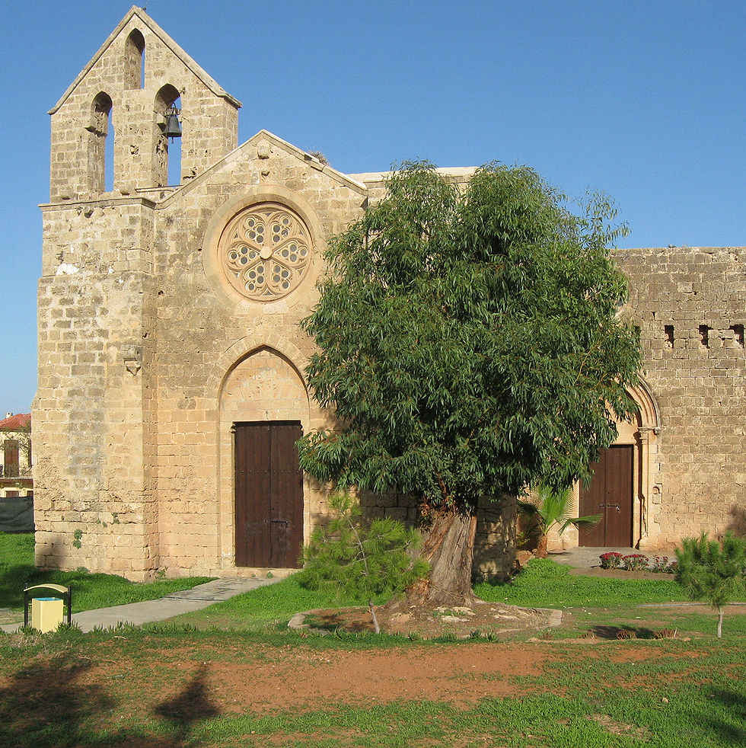
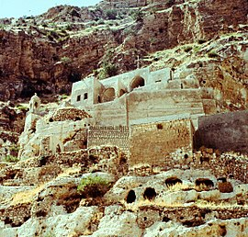
Monastic Communities
Parish Modalities are historically distinct from Monastic Sodalities
At their best, Parish Modalities serve complementary goals to Monastic Sodalities
Sodality members gave up distractions like family, money, and independence to focus on understanding the scriptures and teaching preachers and missionaries.
Modality members lived out the gospel through family, work, and contact with non-Christian society, and provided a structure in which people could grow and mature in their faith.
Notes:
Here’s what happened:
The hermits, like Aphrahat, did come down from the mountains, and “put the call to service above the claims of separation. Purified by prayer and privation they moved beyond the compulsions of self-discipline to the no less demanding task of reviving and leading the church.” (Moffatt, 123)
But they didn’t just become pastors—they gathered together into monasteries. Tradition has it that Aphrahat became bishop of the monastery of Mar Mattai, now in Iraq. These monasteries were the seminaries of the Church of the East, where the monks lived out their vows of celibacy, but also lived near to the congregations, and trained preachers and missionaries for service wherever God would take them.

Slide 19
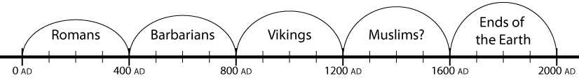
Summary: The First Epoch
Collapse and Jesuits
Persians, India
Arabs, Chinese
Mongols
Egypt
Ethiopia
Nubia
Coastal Africa?
Notes:
Summary:
In this first epoch, the gospel spread rapidly, but questions that have recurred throughout history started to come up:
Should we focus on unity and good theology, or allow for indigenous leaders, even if they seem a little strange?
How should we relate to governments and politicians who want to use Christianity for their own ends?
How do we balance the need to have theological specialists with the needs for everyday Christian life?

Slide 20
Round Two
You’ll find a letter (labelled 400-800) on your table.
Take 7 minutes to read the letter and talk about what advice you would give.
Then, briefly share your dilemma and your approach to it with the class at large.
Notes:
This second 400 years was a lot more chaotic than the previous 400. Rome was torn apart between barbarian warlords. The long stand-off between the Byzantines and the Persians was disrupted when the followers of Muhammad rose as a new political rival, spreading from Arabia to Persia and across North Africa. These new situations brought new dilemmas.

Slide 21
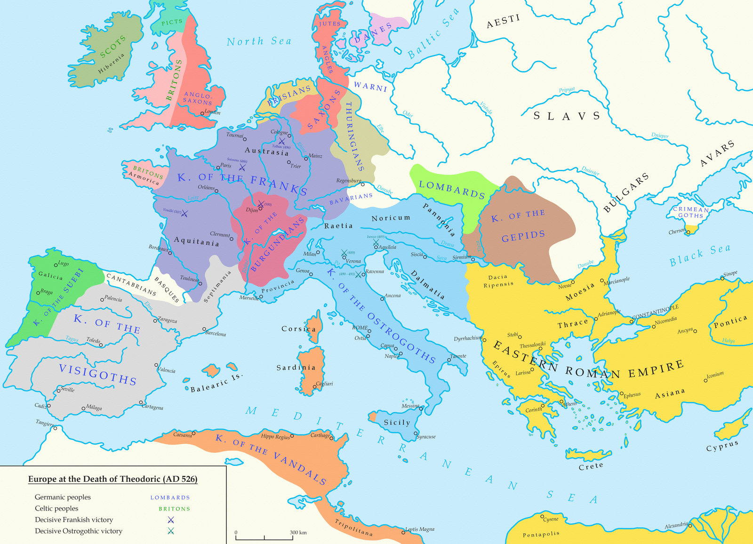
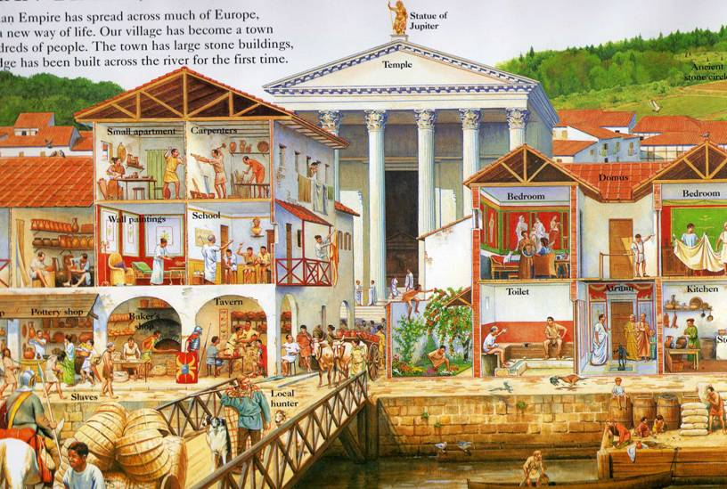
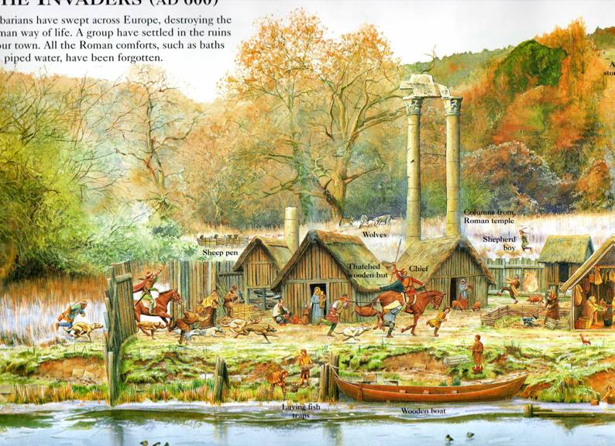
Europe, AD 400-800
Overspending on the military, a wide gap between rich and poor, and a financial crisis weakened the Roman Empire.
No longer held back by Rome, Warlords took over.
At the edge of the empire, in Ireland, early missionaries faced a new challenge:
Should they organize monasteries as outposts of civilization?
Or should their monasteries take new forms familiar to the locals, but disturbing to other Christians?
Notes:
In 476, the Roman Empire collapsed in on itself. Overspending on the military, huge economic divides between the rich and the poor, an over-reliance on slaves and mercenaries, and a severe financial crisis left Rome vulnerable to attack by Goths and Vandals, who divided the territory between them.
Meanwhile, at the edge of the empire, missionaries working in Celtic Ireland ran into a question: how should they organize their monastic life? As outposts of civilization, as was common elsewhere in the Roman world, or in forms that made sense to the local Irish, but that didn’t fit the European mold?
What was your answer?

Slide 22
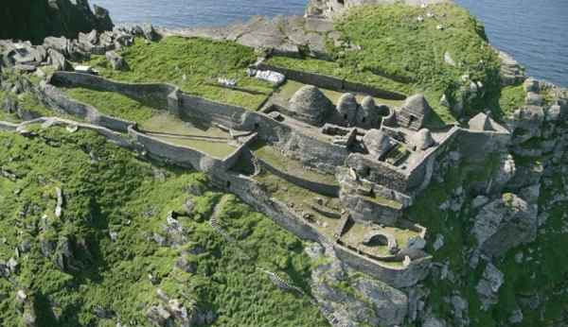
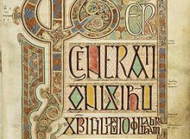
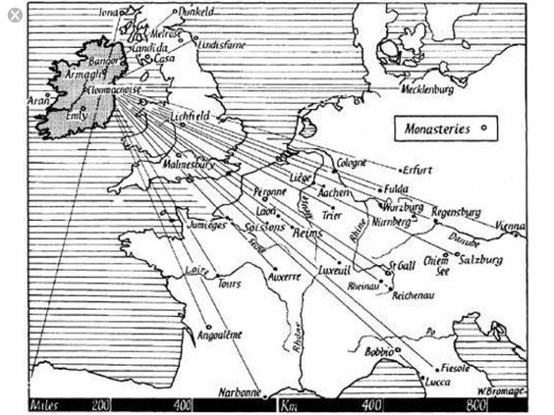
Europe, AD 400-800
Evangelists in Ireland developed a new way of organizing the church, around monasteries, not bishops.
Irish copyists saved the Greco-Roman literary heritage
Irish missionaries re-evangelized Europe, starting Monasteries across the continent.
Notes:
Here’s what happened:
Something somewhat paradoxical happened. The Irish monasteries developed their own way of organizing the church, and in so doing, saved the Roman heritage. Their monks copied Greek and Latin manuscripts, not just of the scriptures, but of Plato, Aristotle, Cicero, and others.
Their model of a monastery as a village and center of hospitality worked so well that that missionaries from Ireland ended up planting monasteries all across Europe, teaching Latin to the Italians, and helping the church survive the hard times after Rome’s collapse, and eventually begin to thrive around 800, with a mini-Renaissance under Charlemagne. Monasteries became the centers of European Christianity, and the incubators of learning and philosophy.

Slide 23
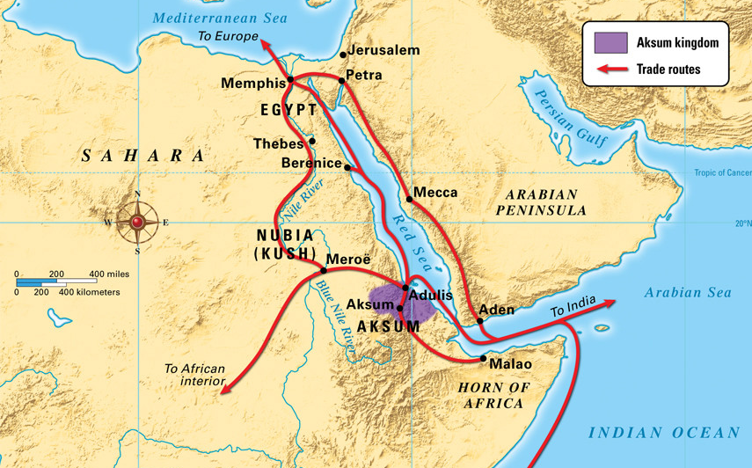
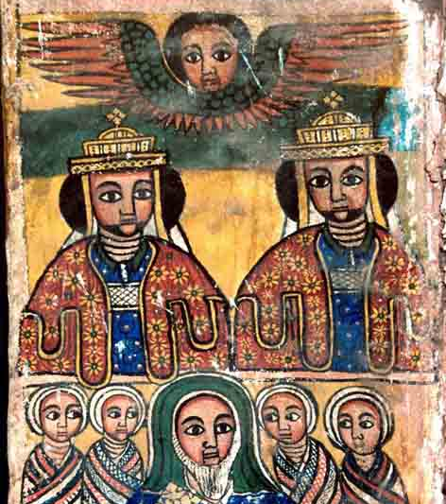
The Shipwreck and the King’s Tutor
Notes:
Before we get to the letter, there is a quick story that needs to be told. In the midst of everything else that had happened in the first 400 years, a young Christian man washed up on the shores of Ethiopia in a shipwreck. He was brought to the King, and ended up employed as the tutor to the young prince, teaching him the language and culture of the Roman empire to the North. Along with that, the tutor taught the prince about Jesus. When the prince grew up and became King, he made his Christianity public, and declared Ethiopia a Christian country. The tutor, when next he visited Alexandria, asked the church to send a bishop to evangelize Ethiopia. Their response was to name him a bishop, and send him back to continue the good work he had begun.

Slide 24
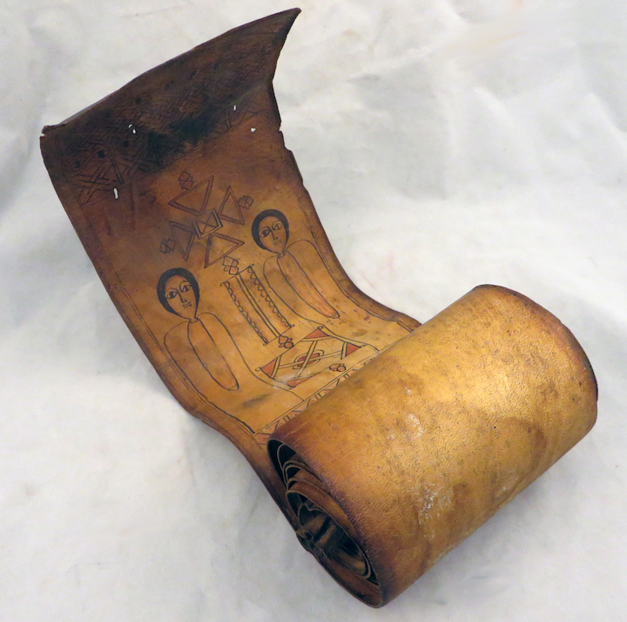

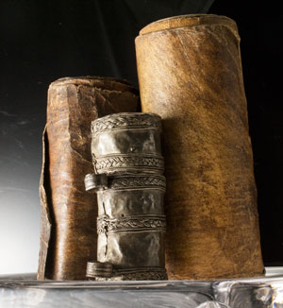
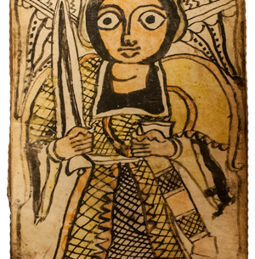
Africa, AD 400-800
Refugees from the religious conflicts in Rome headed south, and ended up in Ethiopia
They found a nominally Christian country, but only a small corridor had been evangelized.
People lived in fear of powerful magicians and spirits, and wanted amulets to protect them.
Should we write scripture on scrolls to remind people of Christ’s protection?
Or does this make Christ just one more magician among others?
Notes:
About 150 years later, a group of nine clergymen, seeking refuge from the church conflicts in Rome, arrived in Ethiopia, and were surprised to find it a nominally Christian country. But only a small part of the country had been reached. So they spread out, preached the gospel, and established hilltop monasteries.
In their outreach, they ran into a dilemma. People’s felt need was for a magical power that could protect them from the world of magic, evil, and spirits that surrounded them. They asked for amulets with scripture written on them that they could tie onto their wrists or necks to protect them.
What was your answer?

Slide 25
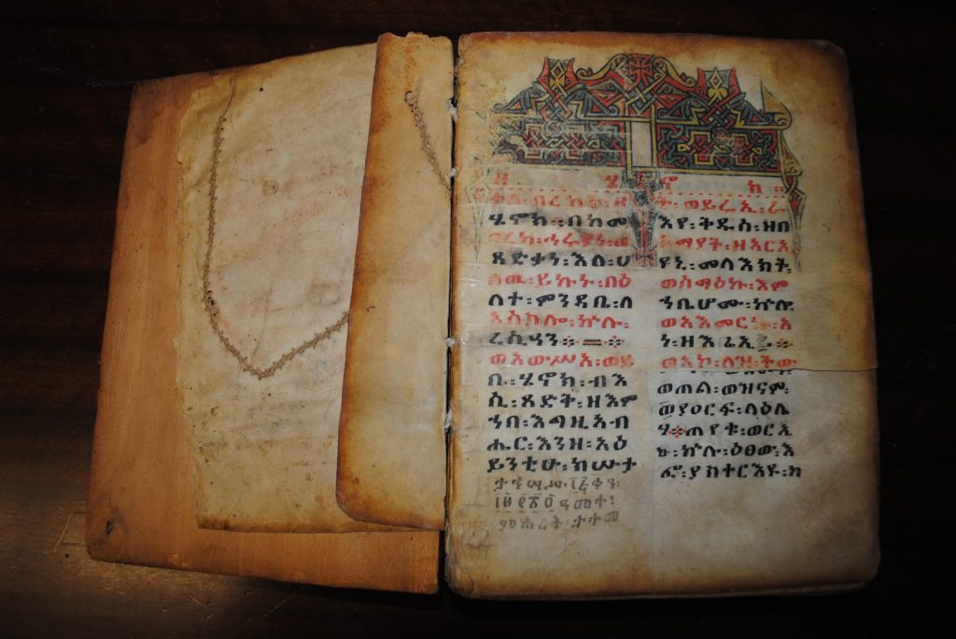
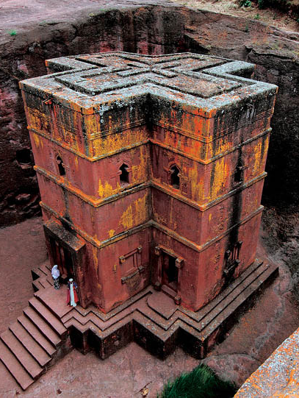
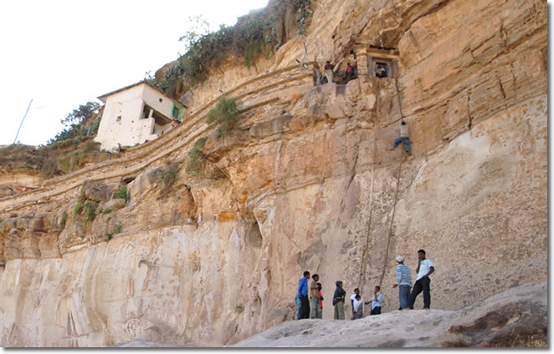
Africa, AD 400 – AD 800
Christianity thrived and grew deep roots in Ethiopia
A significant belief in Jesus’ power as Spiritual protection
Slightly different set of books of the Bible, including 1 Enoch, which deals heavily with Angels, Demons, and Spirits.
Notes:
Here’s what happened:
As it stands, the Ethiopian church has a long history of using amulets with scripture, with pictures of angels, and other formulae on them. We don’t know specifically if the 9 saints (as these preachers came to be called) adopted the practice, but it became widespread. The church in Ethiopia has always been a little different—they recognize a few books as part of the Bible that the rest of the church doesn’t, and they emphasize the importance of Christ’s power as spiritual protection.
But the church has stood the test of time. The church has been a key presence in Ethiopia, witnessing for Christ, for the last 1800 years. And as many scholars have been at pains to point out, from the beginning, Jesus’ death was as much about a victory setting us free from the evil powers as it was anything else—after all, that seems to be why Jesus chose Passover as the time for that final confrontation with the Pharisees.

Slide 26
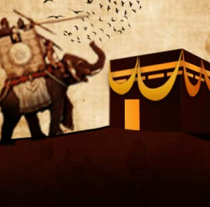
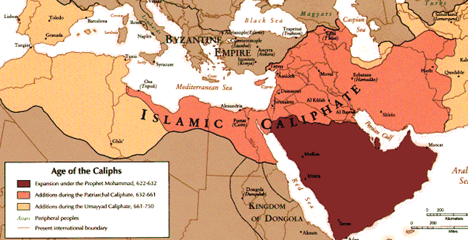
Asia, AD 400-800: The Elephant and its Aftermath
Notes:
One more quick story provides a bridge from Africa to the situation in Asia. Remember, as we discussed earlier, things always get messy when the gospel cozies up to imperial power. In this case, the close association between Christianity and Ethiopian Monarchy had some unexpected consequences. You see, several decades after the 9 sages had passed away, the Ethiopians launched an invasion of Arabia. They crossed the straits into Yemen, then marched north to destroy one of Arabia’s most famous shrines, bringing with them not only an army, but war elephants. In the Arab histories, the enormous army was miraculously stopped, the temple was preserved, and the year was ever afterwards known as the Year of the Elephant. It was in that year, the year of the Elephant, in that town, Mecca, that a man was born who would preach monotheism in Arabia. We will never know what might have been, if he hadn’t grown up in the shadow of an attack by a Christian kingdom.
What we do know is what happened next. He became first a religious, then later a military leader—the first to settle the divisions between the Arab tribes, and unite them into a military force that overwhelmed the neighboring empires. His followers conquered an empire that spread from Spain to Pakistan, creating a Muslim empire that redefined life for the many Christians who continued to live under their rule.

Slide 27
Asia, AD 400-800
Muslim rule brought new challenges to some parts of the church, but were a familiar challenge to others
Some Christians wanted to take a combative tone, insulting Muhammad and Islam, while others emphasized the common heritage of Christian and Muslim teaching.
Meanwhile, missionaries in China met Buddhist missionaries, who asked if they could work together on translating both Christian and Buddhist scriptures into Chinese.
Should we take a combative, competitive stance toward the other religions we encounter?
Should we seek to minimize the differences, in favor of living in harmony?
Notes:
Being under Non-Christian rule was a new experience for the church in Egypt and Syria, but nothing new to the church in Persia. They had been under Zoroastrian rule from the start of the church. The instincts of some parts of the church were combative—calling Muhammad a false prophet, and Islam a forerunner of the Antichrist. Others saw not challenge, but opportunity. There was more common ground with the Muslims than there had ever been with the Zoroastrians. Perhaps emphasizing that common ground could help communicate the gospel?
Interestingly, missionaries who had reached China by this point had a similar dilemma. They found themselves working in the same place as Buddhist missionaries, both working to translate their respective scriptures into Chinese. Should they work alongside the Buddhists, and seek to find some common ground? Or should they take a competitive, combative stance?
What was your answer?

Slide 28
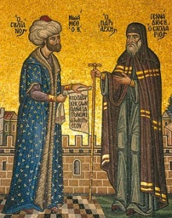

Asia, AD 400 – AD 800
Timothy the Patriarch had a model discussion with the Caliph, gentle, respectful, and insistent on the fundamental importance of Jesus.
Adam Ching-Ching ended up collaborating with the Buddhist Missionary, and Christian writings from the time often have Christian truth with a Buddhist or Taoist “flavor.”
But Chinese and Japanese Buddhism too have concepts that resonate with Christian concepts.
Notes:
Here’s what happened:
Timothy the Patriarch took a very careful, respectful tone with the Caliph. His work should be read by anyone interested in reaching out to Muslims. He expressed genuine appreciation for Muhammad and for Muslim doctrine, but never strayed from emphasizing that belief in what Jesus accomplished in his death and resurrection is non-negotiable.
Ching-Ching ended up closely collaborating with the Buddhist Missionary, Praja, on translations. As a result, the texts that we have from the church in China in this period all have a bit of Buddhist and Taoist “flavor.” But similarly, there are concepts in Chinese and Japanese Buddhism like the Bodhisattva—one who is saved, and in compassion delays their salvation to save others—that are not Christian, but seem to at least rhyme with Christian concepts.

Slide 29
Summary: The Second Epoch
Collapse and Jesuits
Persians, India
Arabs, Chinese
Mongols
Egypt
Ethiopia
Nubia
Coastal Africa?
Notes:
In this epoch again, questions arose that continue to haunt the church.
How far should we adapt our ways of doing mission to local social structures, and how far should we try to change those structures?
How far should our witness be shaped by the felt needs of the people we are reaching out to, and how far does that risk twisting the worldview that frames the Gospel?
How should we approach other organized religions? How far is it helpful to act collaboratively or competitively?

Slide 30
Round Three
You’ll find a letter (labelled 800-1200) on your table.
Take 7 minutes to read the letter and talk about what advice you would give.
Then, briefly share your dilemma and your approach to it with the class at large.
Notes:
This third epoch reflects a time when new powers were rising, conquering and replacing the order established at the end of the last one. At this new turn in history, God’s people faced a new set of challenges.

Slide 31


Africa, AD 800 – AD 1200
Nubian Kings had heard about Christ from Coptic missionaries, and become Christians
Nubia successfully held off Muslim expansion, and negotiated a treaty with them
After supporting an unsuccessful uprising in Egypt, representatives of the Caliph demanded payment on contract, including an interpretation of the contract as promising slaves.
Should we negotiate our payments to protect our country, and with it, the gospel’s foothold in Africa?
Or should we stand up against slavery, whatever the consequences for our nation?
Notes:
Many centuries earlier Nubian Kings had converted to Christ, having heard about him through Coptic missionaries.
Nubia remained beyond the control of the Muslim invaders, but continued to depend on trade with Egypt.
The Caliph’s representatives come back, demanding the sending of slaves, in fulfillment of supposed treaty obligations.
Should we negotiate down to selling a smaller number of slaves, and maintain good relations with Egypt, or should we take a more radical anti-slavery stance?
What was your answer?

Slide 32

Africa, AD 800-1200
Makuria’s representative bargained down the trade costs, so that Makuria was only sending slaves to Egypt once every three years.
In truth, we don’t know much about how integrated into everyday life slavery was at the time
What we do know is that Christians participated in it
We also know that Christianity got no farther south than Nubia and Ethiopia before Portuguese missionaries arrived by sea in the 1400s.
Notes:
Here’s what happened:
Nubia negotiated down to a lower payment, but did end up exporting enslaved people, stolen from lands south of Nubia, and selling them to the Muslim empire to the North.

Slide 33

Africa, AD 800-1200
Here’s the puzzle: Why didn’t Christianity cross the Sahara?
Speculative suggestion:
To go further South, Christianity needed to pass through one of two places: Libya-Morocco or Nubia.
Libya-Morocco, as we know, became mostly Muslim shortly after the Muslim conquest.
Could it be that involvement in the slave trade kept Nubia from witnessing further South?
We don’t know, but I’m sure it didn’t help.
Notes:
Here’s the puzzle: Why didn’t Christianity cross the Sahara?
Speculative suggestion:
To go further South, Christianity needed to pass through one of two places: Libya-Morocco or Nubia.
Libya-Morocco, as we know, became mostly Muslim shortly after the Muslim conquest.
Could it be that involvement in the slave trade kept Nubia from witnessing further South?
We don’t know, but I’m sure it didn’t help.

Slide 34


Europe, AD 800 – AD 1200
Viking invaders have shattered churches, monasteries, and communities across Europe
Byzantine Christians are requesting help against Seljuk invaders from the East
No single country can send an army big enough to save Constantinople
Should the church organize an army to save Christianity from being wiped out?
Or should we turn the other cheek, and try to evangelize the would-be conquerors from within?
Notes:
Viking raids have already weakened the church
Turks are attacking the Byzantines
Should we turn the other cheek?
Or should the church call together an army?
What was your answer?

Slide 35


Vikings and Turks
The church never organized a resistance against the Vikings
As the Vikings made more inroads into Europe, they found a need to improve their image and build alliances with other European leaders
They found this would be easier if they converted to Christianity, so between 900 and 1100, kings of each of the Scandanavian countries converted, establishing churches in their territories.
By contrast, in 1095, the Pope called for the organization of armies to defend Constantinople, beginning the first of the Crusades, which continued for another 200 years.
These wars have been a sore point for Christians and Muslims for most of the past millennium.
Notes:
Here’s what happened:
Against Vikings, no church-organized resistance, though plenty of petty wars.
Vikings officially converted for political reasons between 900 and 1100, slowly Christianizing.
Against Turks, crusades lasting 200 years.
Muslim-Christian relations have been poisoned by this for most of the last millennium.

Slide 36


Asia, AD 800 – AD 1200
Notes:
The big development of this period is the rise of the Mongol Empire under Ghenghis Khan. But there is another story that was taking place in the background, behind the stories of war and politics.

Slide 37

Asia, 800-1200 AD
The good news has reached many of the Mongol tribes!
The widowed Queen Sorkhakhtani asks for advice
Should she marry a violent, cruel, and foolish man to exert godly influence on the empire?
Or should she steward her provinces and focus on raising her own sons as wise, God-fearing men?
Notes:
The good news has reached many of the Mongol tribes!
The widowed Queen Sorkhakhtani asks for advice
Should she marry a violent, cruel, and foolish man to exert godly influence on the empire?
Or should she steward her provinces and focus on raising her own sons as wise, God-fearing men?
What was your answer?

Slide 38



Asia, AD 800 – AD 1200
Hulegu, Ilkhan of Persia (1256-1265)
Möngke, Great Khan of the Mongols (1251-1259)
Kublai, Great Khan of the Mongols, Yuan Emperor of China (1260-1294)
Notes:
Here’s what happened:
Sorkhakhtani turned down the proposal of marriage, and raised her 4 sons. Of those 4, one became Great Khan over all the Mongols, one became Ilkhan over Persia, one became Kublai Khan. Each was famed for their wisdom and their tolerant attitude toward other religions. Though none of them became Christians, all were married to Christian princesses. Christianity flourished in the Mongol period, though it never gained the dominance it had in Europe. When the traveler Marco Polo met with Kublai Khan, the great Khan even extended an invitation to send 100 missionaries to reinforce Christianity in his empire. In the end, one missionary arrived, 18 years later.

Slide 39
Summary: The Third Epoch
Turks
and Vikings
Collapse and Jesuits
Persians, India
Arabs, Chinese
Mongols
Egypt
Ethiopia
Nubia
Coastal Africa?
Notes:
In this Epoch, we’ve dealt heavily with one question, in three different lights:
When Christian people have power, how do we exercise that in a way that doesn’t compromise the message of Christ?

Slide 40
Round Four
You’ll find a letter (labelled 1200-1600) on your table.
Take 7 minutes to read the letter and talk about what advice you would give.
Then, briefly share your dilemma and your approach to it with the class at large.
Notes:
This epoch sees immense changes around the world. Europe undergoes some profound challenges, while the Mongols fade, and seaborne trade brings new challenges.

Slide 41


Europe, AD 1200 – AD 1600
The upper classes are Christian, but most people relate to God transactionally
The church has become heavily corrupt, selling pieces of paper that supposedly grant forgiveness of sins
Should we join the anti-monastic reformers?
Or do we need a new, more radical form of monastic devotion?
Notes:
The upper classes are Christian, but most people relate to God transactionally
The church has become heavily corrupt, selling pieces of paper that supposedly grant forgiveness of sins.
Anti-monastic reformers say we need to get the monks out of the monasteries and get them preaching to normal people in their own language.
Other reformers see a need for a more profound monasticism, selling everything, living on alms, wandering the country to do the work of Christ.
Should we join the anti-monastic reformers?
Or do we need a new, more radical form of monastic devotion?
What was your answer?

Slide 42


Europe, AD 1200-1600
Mendicant Orders:
Franciscans, Dominicans, and Jesuits
Each represented attempts at a more radical monasticism.
These orders became the main vehicle for the gospel to cross cultural boundaries until the 1700s.
Reformed Churches:
Lutheran, Calvinist, Anglican, and Anabaptist
These focused on bringing Christ to laypeople in language they could understand
Made a great deal of progress in expanding Christianity among the common people of Europe
But both directed a great deal of their efforts at fighting each other
Notes:
Here’s what happened:
Both happened. The mendicant orders excelled at taking the gospel to places it had not yet reached
The reformed churches excelled at taking Christianity beyond the elite to the common people, using new translations, an increased focus on scripture, preaching, and rationalist theology.
But both spent a great deal of their energy and resources fighting each other

Slide 43


Asia, AD 1200 – AD 1600
In the anti-Mongol response, the church nearly disappears. Islam resurges in Persia, and Confucianism in Ming China
As Nestorian influence fades, Catholic missionaries enter the scene.
Should the new missionaries show willingness to learn local customs and philosophies?
Or is it more important to stand out in the midst of a hostile culture?
Notes:
In an anti-Mongol response, the Church of the East nearly disappears, persecuted by Muslims in Persia, and Confucians in China.
But just as Nestorian influence is fading, Franciscan, Dominican, and Jesuit missionaries begin to arrive from Europe.
Matteo Ricci arrives in Zhàoqìng, eager to proclaim Christ. Some expect him to open a church and start holding Mass in Latin right away. But he is thinking about it more deeply. He sees that the people in Zhàoqìng respect the Confucian scholars.
Should he spend the time to become a Confucian scholar, so that he can present the faith in Confucian terms, with that stature?
What was your answer?

Slide 44

Asia, AD 1200 – AD 1600
Matteo Ricci and his collaborators dive deeply into the study of Confucian philosophy
He becomes known for presenting the gospel not as a foreign concept, but as the fulfillment of Chinese and especially Confucian worship of the Lord of Heaven (Tiānzhǔ).
He successfully gets a hearing for the gospel in the highest intellectual circles of Beijing society
By 1692, the emperor had issued an edict of toleration of Christianity, elevating it to an equal status with Confucianism
Notes:
Here’s what happened:
Ricci did indeed become a Confucian scholar, and became a respected member of the intellectual life of the Chinese capital, Beijing. He was known for presenting the gospel not as a foreign concept, but as the fulfillment of Chinese, and especially Confucian worship of the Lord of Heaven (Tiānzhǔ). He gets in trouble with other Christians for his support of ancestor veneration
By 1692, the emperor had issued an edict of toleration of Christianity, elevating it to an equal status with Confucianism

Slide 45


Africa, AD 1200 – AD 1600
Dependence on clergy from Egypt results in the slow collapse of the church in Nubia
King Afonso I of Manicongo (now Angola) has come to know Jesus through contact with Portuguese priests
He wants to see the gospel spread through the country
Should he focus on bringing a few, well-trained teachers from Portugal?
Or should he support a large number of Angolan lay preachers, even though they won’t be as well trained?
Notes:
The last word we hear from the Nubian church is a request for for priests submitted to the King of Ethiopia, because they had lost contact with the church in Egypt, and were not training priests of their own.
At about the same time, on the Southwest coast of Africa, King Afonso I, aka Mvemba a Nzinga is wrestling with his own question about clergy. He’s been visited by Portuguese explorers and slave traders, but priests came along on one of the ships, and taught him about Jesus. He has become a passionate follower of Jesus, and wants to see the gospel spread throughout his kingdom. He is deciding between asking the Portuguese to send priests to evangelize his country, or getting locals, less well trained in the gospel, to spread the word.
What was your answer?

Slide 46


Africa, AD 1200 – AD 1600
He recruited and supported a large number of lay, Angolan teachers to spread the gospel throughout the country
Despite anti-religious policies under communist rule from 1977-1991, Angola remains over 90% Christian, more or less evenly split between Catholics and Protestants
Notes:
Here’s what happened:
King Afonso is remembered for his commitment to bringing the message of Jesus to his country, and to educating his people
The chaplain sent to assist him recalls him studying theological textbooks to find ways to merge Angolan religious traditions with Christianity until falling asleep over the textbooks
He recruited and supported a large number of lay, Angolan teachers to spread the gospel throughout the country
Despite anti-religious policies under communist rule from 1977-1991, Angola remains over 90% Christian, more or less evenly split between Catholics and Protestants

Slide 47
Summary: The Fourth Epoch
Turks
and Vikings
Monastic
Reform
Backlash and Jesuits
Persians, India
Arabs, Chinese
Mongols
Decline
and Coastlands
Egypt
Ethiopia
Nubia
Notes:
In this tragic epoch, we’ve engaged some other key missiological questions:
Do we need sodality-like structures? Why?
What happens when indigenous churches are not self-theologizing?
What happens when churches are not self-governing, self-supporting, or self-propogating?

Slide 48
Round Five
You’ll find a letter (labelled 1600-2000) on your table.
Take 7 minutes to read the letter and talk about what advice you would give.
Then, briefly share your dilemma and your approach to it with the class at large.
Notes:
Shortly before this epoch begins, Europeans discover reliable sea routes across the Atlantic Ocean. This gives them access to North and South American natural resources. This, along with the labor of enslaved people from Africa provides Europe the economic boost that it needs to dominate and colonize most of the rest of the Old World—Africa and Asia, for several centuries. Europe’s colonial expansion posed a new set of challenges for European missionaries and for those they spoke with about Jesus.

Slide 49


Asia, AD 1600 – AD 2000
In 1707 , the first Lutheran missionaries were sent out to a Danish colony
They found Jesuits had already been at work there for 100 years
Both emphasize local language and literature
Jesuits preferred to adopt local styles and worship customs, while Lutherans preferred simplicity, but a bigger question loomed:
Should the new missionaries follow custom by evangelizing high and low castes separately?
Or should they insist on bringing different castes together in Christ?
Notes:
In 1707 , the first Lutheran missionaries were sent out to a Danish colony
They found Jesuits had already been at work there for 100 years
Both emphasize local language and literature
Jesuits preferred to adopt local styles and worship customs, while Lutherans preferred simplicity, but a bigger question loomed:
Should the new missionaries follow custom by evangelizing high and low castes separately?
Or should they insist on bringing different castes together in Christ?
What was your answer?

Slide 50

Asia 1600 – 2000
Careful histories of the Catholic communities show that the Jesuit way:
They regarded caste distinction as a neutral, not idolatrous social division
Initially appealed heavily to upper-castes
Got caught up in the ritual-political world in ways similar to Hindu shrines
But eventually also became resources for lower-caste political assertion.
Lutherans initially followed the Jesuit example, and permitted Caste distinctions, with some differences
Their mission appealed more to lower-caste Hindus
In the 1830s, attempted to insist on renunciation of caste
This resulted in a split in the church
Notes:
Here’s what happened:
Careful histories of the Catholic communities show that the Jesuit way:
They regarded caste distinction as a neutral, not idolatrous social division
Initially appealed heavily to upper-castes
Got caught up in the ritual-political world in ways similar to Hindu shrines
But eventually also became resources for lower-caste political assertion.
Lutherans initially followed the Jesuit example, and permitted Caste distinctions, with some differences
Their mission appealed more to lower-caste Hindus
In the 1830s, attempted to insist on renunciation of caste
This resulted in a split in the church

Slide 51
Europe and the Antipodes 1600-2000
Moravian Missionaries sought to reach out to Iroquois, Mohican, Shawnee, and Lenape tribes in Pennsylvania
English Puritan missionaries had attempted to extract Indian believers, disconnecting them from their tribes and teaching them English ways.
French Catholic missionaries spread themselves out, becoming parts of existing tribe, seeking to convert tribes as a whole
Should we seek to extract new believers from their tribes into new Christian communities?
Or should we seek to let go of our European settlements in order to preach the gospel to tribes that already live here?
Notes:
Europe and the Antipodes:
Moravian Missionaries sought to reach out to Iroquois, Mohican, Shawnee, and Lenape tribes in Pennsylvania
English Puritan missionaries had attempted to extract Indian believers, disconnecting them from their tribes and teaching them English ways.
French Catholic missionaries spread themselves out, becoming parts of existing tribe, seeking to convert tribes as a whole
Should we seek to extract new believers from their tribes into new Christian communities?
Or should we seek to let go of our European settlements in order to preach the gospel to tribes that already live here?
What was your answer?

Slide 52

Europe and the Antipodes 1600-2000
Zeisberger went to live with many of the local tribes, and brought many to faith
Many, rejected by their tribes, ended up gathering into Christian Indian villages
But in 1782, US Militiamen came upon one of the villages—Gnadenhutten, Ohio. The militiamen voted to massacre the Indians and burn down their village
No criminal charges were filed
Notes:
Here’s what happened:
Zeisberger went to live with many of the local tribes, and brought many to faith
Many, rejected by their tribes, ended up gathering into Christian Indian villages
But in 1782, US Militiamen came upon one of the villages—Gnadenhutten, Ohio. The militiamen voted to massacre the Indians and burn down their village
No criminal charges were filed

Slide 53

Africa, AD 1600 – AD 2000
David Livingstone writes for advice about disrupting the slave trade
He has an opportunity in Zambia to attempt to open a new trade route to develop local farming and industry
Should he work with this community to usher in economic change?
Or is mixing economics with the gospel going to advance the cause of trade more than the cause of Christ?
Notes:
David Livingstone writes for advice about disrupting the slave trade
He has an opportunity in Zambia to attempt to open a new trade route to develop local farming and industry
Should he work with this community to usher in economic change?
Or is mixing economics with the gospel going to advance the cause of trade more than the cause of Christ?
What was your answer?

Slide 54

Africa, AD 1600-2000
Livingstone decided to make the trip, and opened a river-based trade route from West Africa to East Africa
The economies of African countries shifted profoundly. Slavery was eventually outlawed
However, many parts of Africa became economically dependent on colonizing countries
To this day, many criticize Christian missionaries for legitimizing imperial conquest and economic exploitation
Notes:
Here’s what happened:
Livingstone decided to make the trip, and opened a river-based trade route from West Africa to East Africa
The economies of African countries shifted profoundly. Slavery was eventually outlawed
However, many parts of Africa became economically dependent on colonizing countries
To this day, many criticize Christian missionaries for legitimizing imperial conquest and economic exploitation

Slide 55
Summary: The Fifth Epoch
Turks
and Vikings
Monastic
Reform
Backlash and Jesuits
Persians, India
Arabs, Chinese
Mongols
Decline
and Coastlands
Egypt
Ethiopia
Nubia
Notes:
In this epoch we get increasingly close to the modern day, and with it to some unsolved questions.
How should the gospel be preached in societies divided by caste, race, language, and other divides?
How do we preach Jesus to Native Americans, Aboriginal Australians, and others whose lands were taken by settler colonists?
Can it be helpful to mix business and preaching the gospel? When and how?

Slide 56










¹Therefore, since we are surrounded by such a great cloud of witnesses, we must get rid of every weight and the sin that clings so closely, and run with endurance the race set out for us, ²keeping our eyes fixed on Jesus, the pioneer and perfecter of our faith.
Hebrews 12:1-2a
Notes:
So now I leave you with one final thought. All of these people, Clement, Eusebius and Aphrahat, Brigid, Za-Michael, and Timothy, Giorgios, Sorkhakhtani, Katie, Matteo, Afonso, Barthlomaus, Anna, David, and so many others whose stories we haven’t had time to tell—mystics and teachers, lovers of the poor and preachers to the great—millions upon millions of believers across continents and across the ages have taken their places as witnesses to what Christ has done. The book of Hebrews offers us an image of these men and women of faith cheering for us like older brothers and sisters cheering at a track meet, saying “Keep going! Drop whatever is holding you back! Keep your eyes on King Jesus! He is worthy, for he was slain, and by his blood he ransomed people for God from every tribe and language and people and nation, and he has made them a kingdom and priests to our God, and they shall reign on the earth. To him who sits on the throne and to the Lamb be blessing and honor and glory and might forever and ever!”

